Slide 1
NYC Motor Vehicle Collision Analysis
Urvashi Gupta

Slide 2

Project Details
Overview
The problem statement involves analyzing New York City motor vehicle collision data to understand the reasons and pattern of road accidents in various boroughs of the city.
Dataset
The problem statement involves analyzing New York City motor vehicle collision data to understand the reasons and pattern of road accidents in various boroughs of the city.
Data Features
borough
contributing_factor_vehicle_1
contributing_factor_vehicle_2
contributing_factor_vehicle_3
contributing_factor_vehicle_4
contributing_factor_vehicle_5
cross_street_name
timestamp
latitude
longitude
location
number_of_cyclist_injured
number_of_cyclist_killed
number_of_motorist_injured
number_of_motorist_killed
number_of_pedestrians_injured
number_of_pedestrians_killed
number_of_persons_injured
number_of_persons_killed
off_street_name
on_street_name
unique_key
vehicle_type_code1
vehicle_type_code2
vehicle_type_code_3
vehicle_type_code_4
vehicle_type_code_5
zip_code

Slide 3
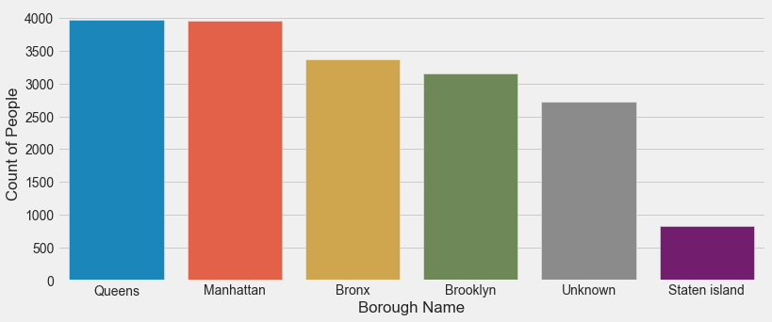
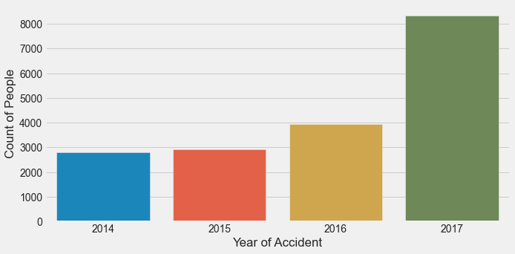
Exploratory Data Analysis
[Contd..]
Distribution of Accidents Across Boroughs
Distribution of Accidents Over Years
22.1%
21.9%
47%
19%
17%
15%
22%
15%
16%
5%
Key Observations
Key Observations
Key Observations
Above graph shows distribution of accidents for 5 different boroughs from Jan 2014 till Dec 2017
The graph shows that maximum number of accidents have happened in Queens and Manhattan, followed by Bronx, Brooklyn and Stalen Island
Above graph shows distribution of accidents from Jan 2014 till Dec 2017
The graph shows that accidents in NYC have increased since 2014 with cases being at peak in year 2017 i.e. 47%

Slide 4
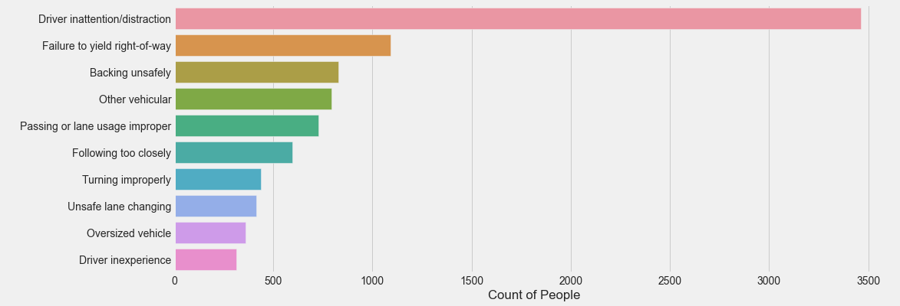
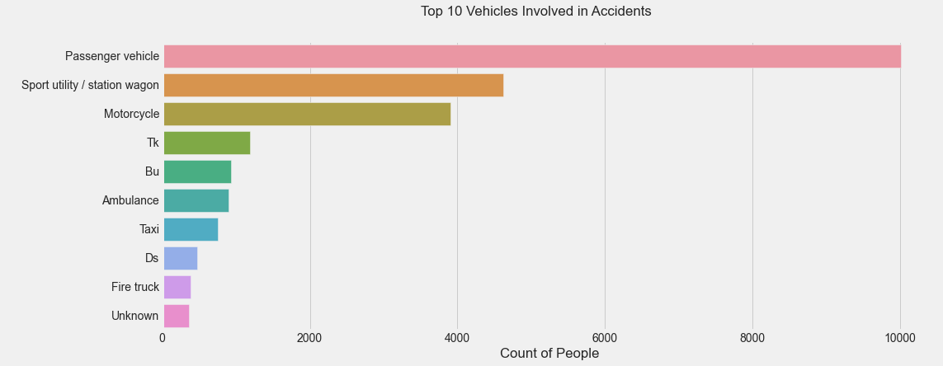
Exploratory Data Analysis
Top 10 Factors Contributing to Accidents
30%
Key Observations
Graph shows that top 10 reasons of accidents from Jan 2014 till Dec 2017 in NYC
We can deduce that that driver distraction is one of the major reasons of accidents across boroughs
9%
7%
6.8%
6.2%
5%
4%
3.6%
3%
2.6%
Top 10 Vehicles Causing Accidents
Optum Commercial BPO
37%
Key Observations
Graph shows that top 10 vehicles causing accidents from Jan 2014 till Dec 2017 in NYC
We can deduce that that passenger vehicle is one of the main vehicles causing accidents across boroughs
Ambulance also contributes to good fraction of accidents
17%
15%
5%
3.4%
3.1%
2.8%
1.7%
1.1%
1%

Slide 5
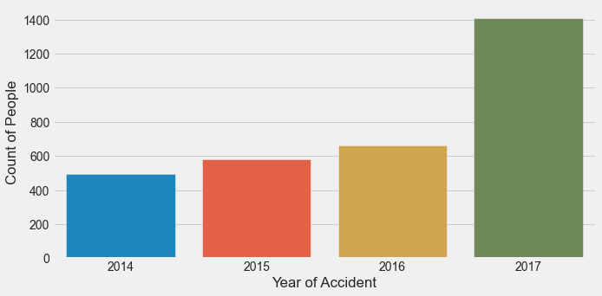
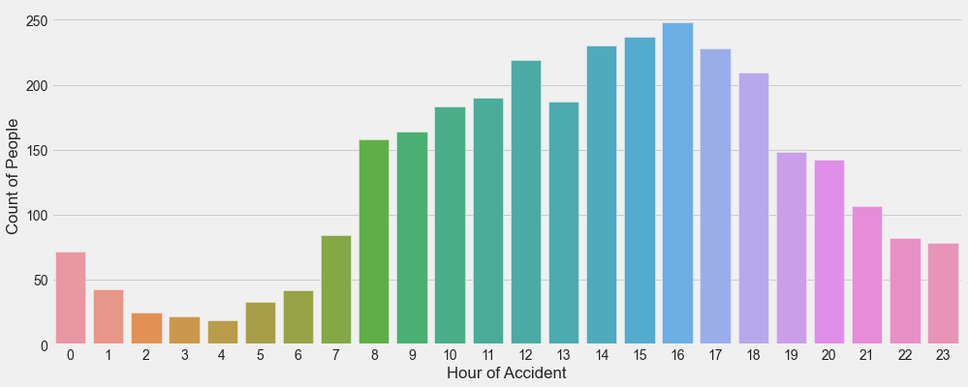
Exploratory Data Analysis - Brooklyn
[Contd..]
Distribution of Accidents Over Years
Accidents Across Different Hours of the Day
44%
22%
19%
15%
Key Observations
Key Observations
Key Observations
Above graph shows distribution of accidents from Jan 2014 till Jan 2017 in Brooklyn
The graph shows that accidents have increased since 2014 with cases being at peak in year 2017 i.e. 44%
Above graph shows hour-wise distribution of accidents from Jan 2014 till Jan 2017 in Brooklyn
We can observe here that major proportion of accidents have happened during peak hours when people are travelling for work etc. i.e. between 8 am till 7 pm

Slide 6
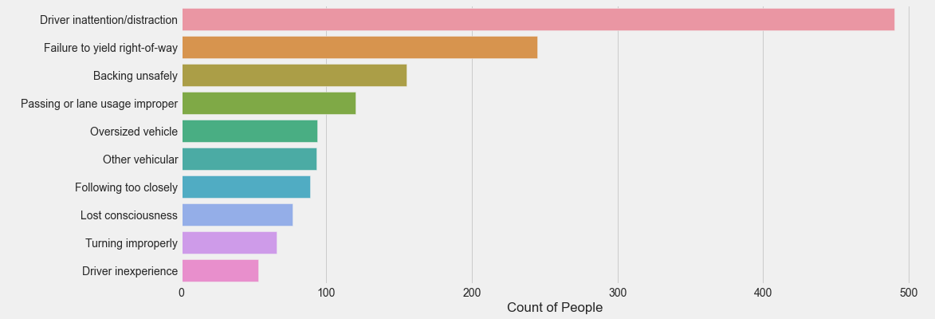
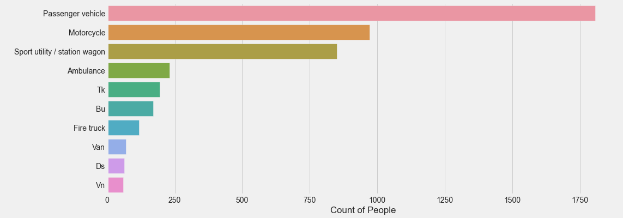
Exploratory Data Analysis - Brooklyn
Top 10 Factors Contributing to Accidents
25%
Key Observations
Graph shows that top 10 reasons of accidents from Jan 2014 till Dec 2017 in NYC
We can deduce that that driver distraction is one of the major reasons of accidents across boroughs
12%
8%
6%
5%
4.7%
4.5%
4%
3.3%
2.6%
Top 10 Vehicles Causing Accidents
Optum Commercial BPO
35%
Key Observations
Graph shows that top 10 vehicles causing accidents from Jan 2014 till Dec 2017 in NYC
We can deduce that that passenger vehicle is part of 35% of accidents across all boroughs, while Ambulance is 3rd highest with 4% accidents
19%
16%
4%
3.8%
3%
2.2%
1.3%
1.1%
1%

Slide 7
Recommendations
Strengthen Law Enforcement and Penalties
Analysis shows that 25% of accidents in NYC and Brooklyn specifically have happened due to driver distraction. Hence, strengthening the laws for using hand-held cell phones while driving, for drink and drive, wearing seat belts etc. can help
Improve Public Transport Facility
In Brooklyn itself we can see ~35% of accidents are happening due to passenger vehicles. Hence facilitating good transport system can help to reduce accidents
1
Investing in Infrastructure
Authorities can invest in designing better infrastructure such as speed humps, traffic circles, traffic lights, speed and red-light cameras which can reduce accidents
6
2
Customizing Speed Levels in Vehicles
Some of the customizations like speed limits based on street designs e.g., different speeds for narrower lanes, wider sidewalks, raised crosswalks and curb extensions
Highlights
5
3
Improve Road User Education and Public Advocacy
Measures such as implementing comprehensive driver licensing programs where young drivers can undergo driving learning programs
4
Speeding up Emergency Response and Care
This can help to prevent deaths as people affected due in fatal crashes can get good first aids. Hospital-based mobile medical teams can work efficiently with ambulance services, local police and fire services to provide speedy response

Slide 8
Thank You

